Slide 1

NCUSIF Public Education Campaign Update
John McKechnie
Director, Office of Public & Congressional Affairs

Slide 2

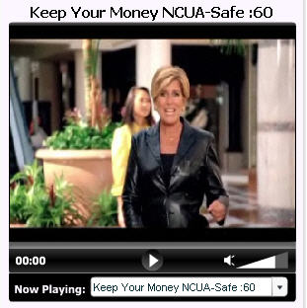
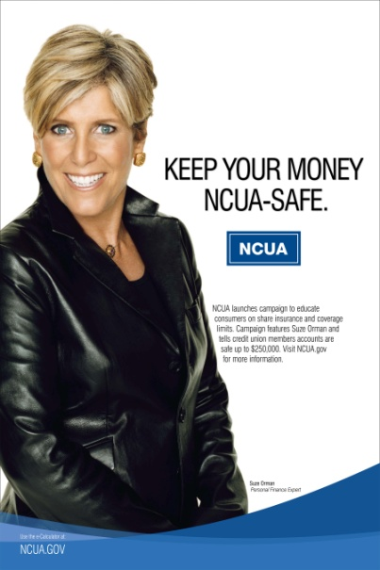
Public Service Announcements (PSAs)
TV: Electronic and hard copies sent to 1,500 cable and network stations
  Favorable response from NBC, CBS and ION TV networks
Radio: Electronic and hard copies sent to 4,300 cable and network stations
Out-of-Home: Billboards in Malls and Bus Shelters
PSA pick-up expected in the coming weeks

Slide 3
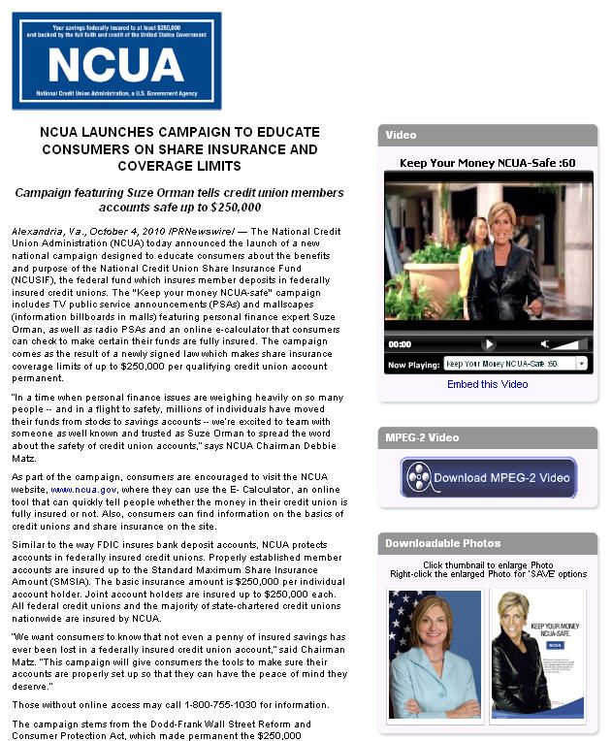



Multimedia News Release
Press Release and
Campaign Assets
  Audience reach: 148,072,000
  Page views: 2,949
  Online video views: 16,580
  Press Release Pick-up: 216
3

Slide 4




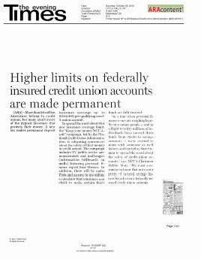
Matte Release
Online
  Site audience: 11,847,672
  Total placements: 737
  Online ad value: $247,813
Pick-up
  Majority of print pick-up expected to run
  in 3-5 weeks

Slide 5



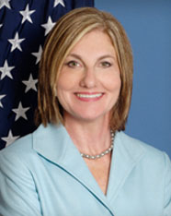

Radio Media Tour
Interviews with Chairman
Matz to promote Campaign
  12 total interviews
  2,799,000 potential listeners
  993 stations reached

Slide 6
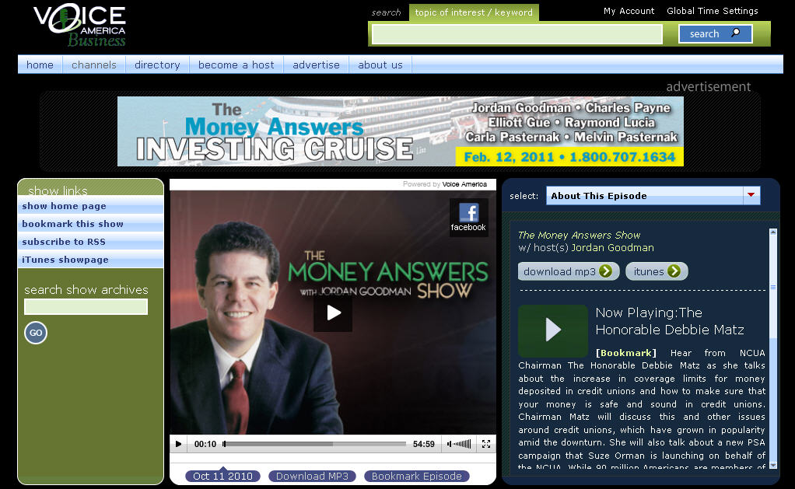
Jordan Goodman Radio Internet Interview

Slide 7
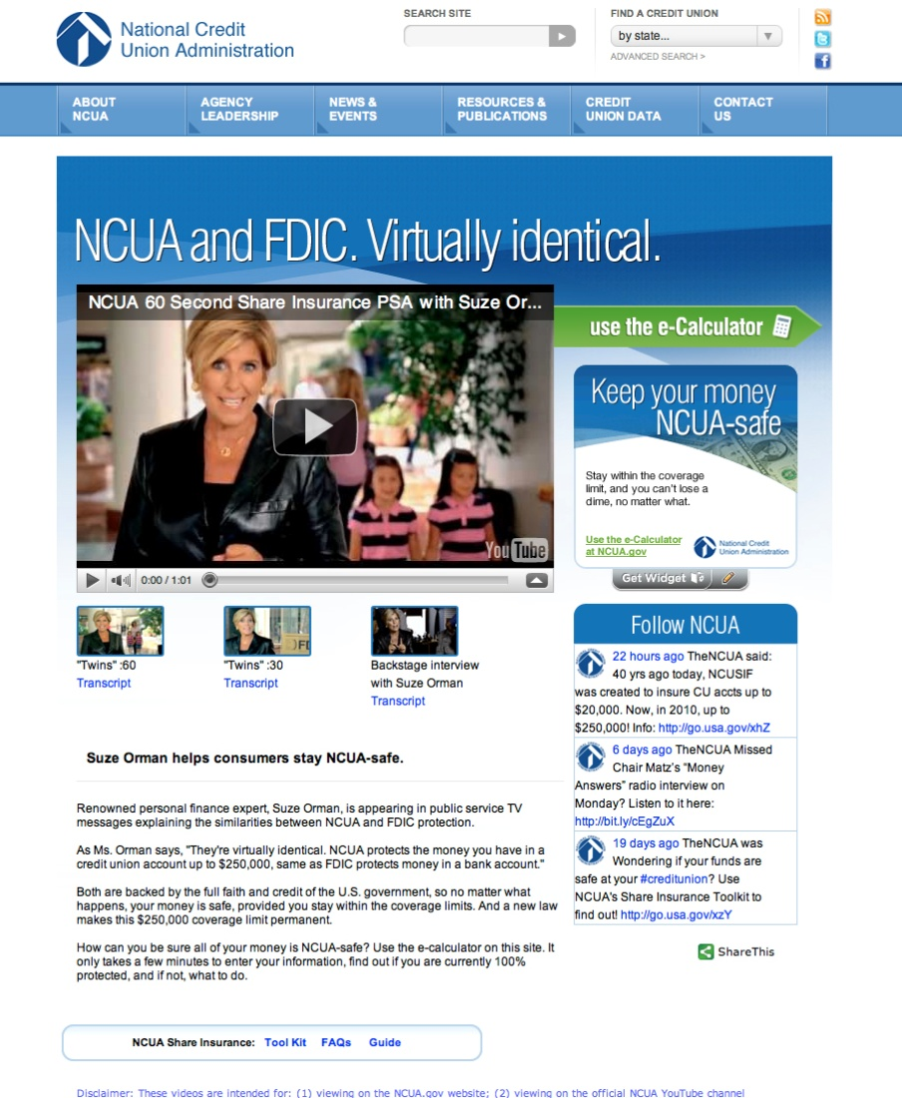
Campaign Landing Page: NCUA.gov/ncuaSafe
Houses Campaign Assets
  TV PSAs
  Widget
  e-Calculator
  Twitter Feed
Stats
  Page Views: 3,278
  Page Visits: 2,544

Slide 8
Social Media Outreach
Twitter
  Purpose: Outreach to credit unions, financial bloggers and the general public.
  Activity: Daily Tweets about the campaign with links to campaign landing page.
Facebook
  Purpose: Outreach to general public, specifically people who are unfamiliar with NCUA.
  Activity: Daily short messages about the campaign with links to ncua.gov and the campaign landing page.
YouTube
  Purpose: Location where the TV PSAs are housed so that financial bloggers and general public can access the PSAs.
  Activity: TV PSAs and Behind-the-Scenes interview available, supplemented by weekly NCUA comments about the campaign.

Slide 9
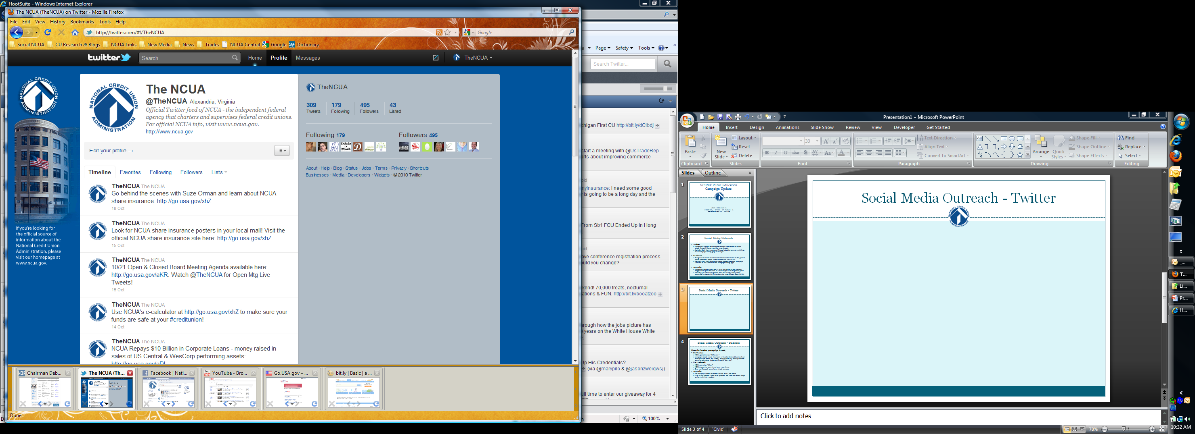
Social Media Outreach - Twitter

Slide 10
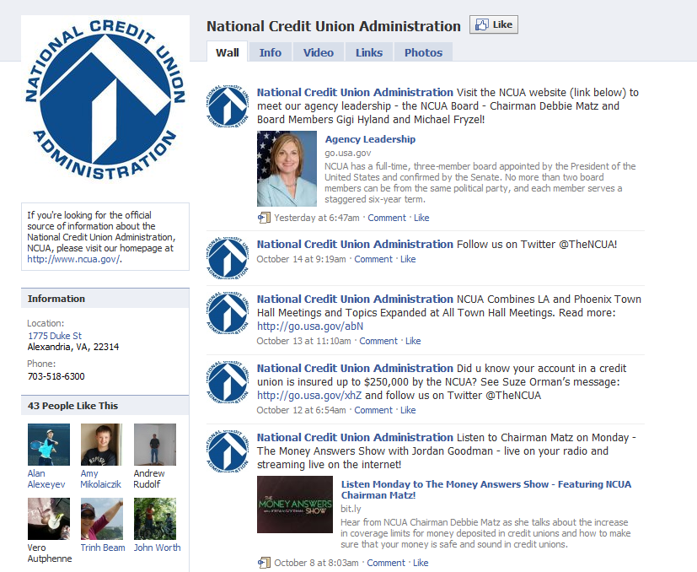
Social Media Outreach - Facebook

Slide 11
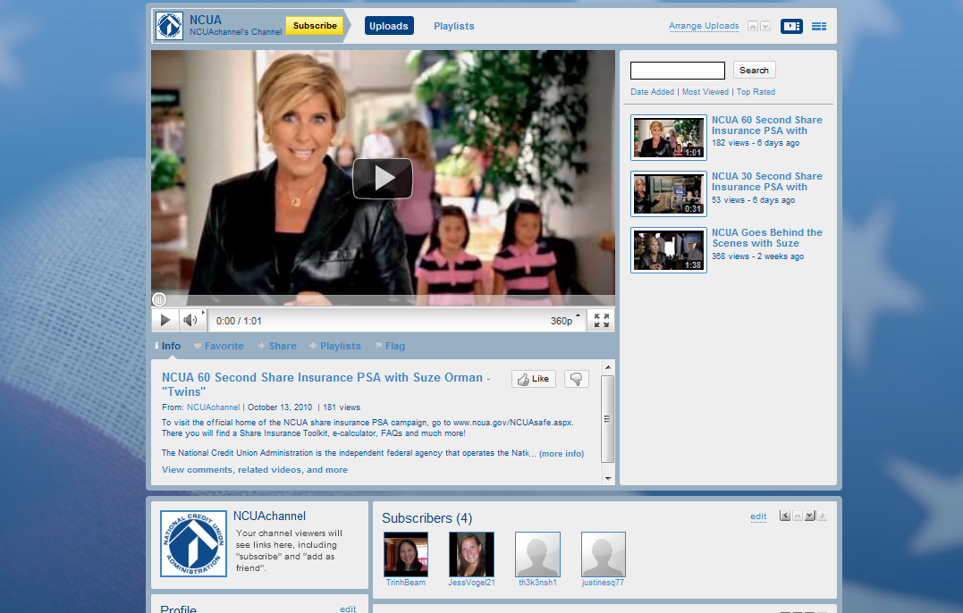
Social Media Outreach - YouTube

Slide 12
Social Media Outreach - Statistics
Since the October 4 campaign launch,
On Twitter:
  NCUA gained 70 new “Followers.”
  Campaign related tweets have been re-tweeted (shared by one of our Followers with others on Twitter) over 25 times, by over 15 different users (credit unions, trades and financial bloggers).
On Facebook:
  NCUA gained 43 “Likes.”
  NCUA’s page has been viewed over 1,500 times.
  Over 150 Facebook users have visited our page.
YouTube
  The campaign videos have been viewed over 1,700 times.

